Slide 1
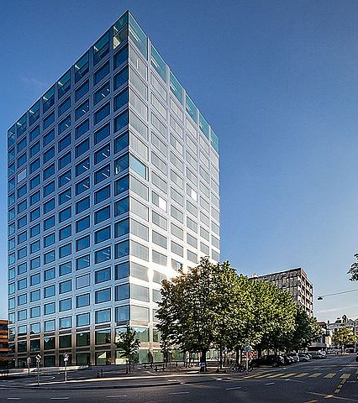
Onboarding Process for External IT Maintenance Staff
Ferro J., Herzog J., Romero M, Locher J.

Slide 2
Table of content
Use case & the problem
Solution overview - What we built
Demonstration
Conclusion
Notes:
Intro (0.5 min) Jonas
Use case & the problem (of AS-IS process) (2 min) Jonas
Solution overview - What we built (2.5 min) (Mélanie)
Demo (2.5 min) (Jan)
Conclusion (2) Justine
= 10 Minutes

Slide 3





Use case & Problems
Transparency &
Standardization
Inconsistent Process
Execution
Lack of
Transparency & Standardization
Manual Effort
Back and Forth Communication
Error Handling
Goal: Digitize and streamline it using Camunda, Human-centric interfaces, service integration, decision automation and digital data
Notes:
2 Minutes - Jonas
Today we’re excited to walk you through a real process at the University of Basel and how we modernized and improved it.
Imagine you're an external IT partner like someone from Solutions AG. You need quick access to internal systems to do your job. But instead, you’re stuck in a slow, manual, paper-based process.
We are of course, talking about the Onboarding Process for External IT Staff.
These are the problem areas of the process we set out to tackle:
The process gets executed inconsistently as each IT team executes it differently.
There is a lack of standardization as well as transparency because of ad-hoc execution
A lot of tasks remain manual and therefore generate unnecessary personnel costs
There is lots of back-and-forth communication with the IT Service Desk,
And there is no error handling in place.
Our goal was to digitalize and streamline this process using Camunda and Make. This involved creating a digital form and automated routing via decision tables among other things.
But for the details i give over to Melanie.

Slide 4
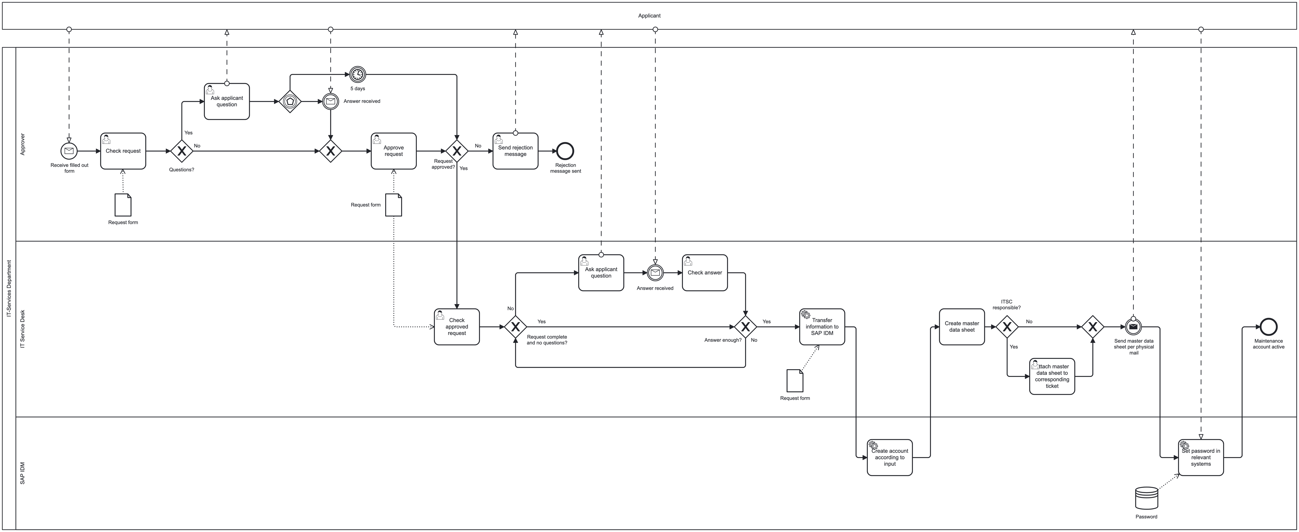
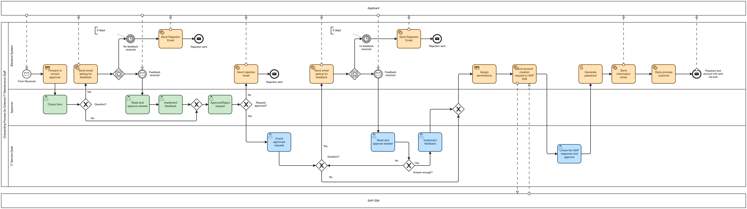
AS-IS process
TO-BE process
Notes:
2.5 Minutes – Melanie
Here you see the old process model on top and the new one at the bottom which I will explain on the next slide

Slide 5








06
What we built
External requests submitted via a digital form
Automated routing and approvals based on business rules
Real-time email notifications and feedback loops
Request data stored and monitored transparently
05
Notification & Data Storage
04
Automated Account Setup
Applicant is notified via email.
Process outcome is logged in a Google Sheet.
Credentials are sent by post.
03
Technical Review by IT Service Desk
02
System assigns permissions.
SAP system processes the account creation request.
Password is generated.
Approval & Feedback Loop
01
The approved request is checked for technical compatibility.
Feedback is requested if needed.
Automatic Routing to the Right Approver
Applicant Submits Digital Form
Approver reviews the request.
If needed, requests additional information from the applicant.
Approves or rejects the request.
The system uses decision logic to forward the request to the correct person.
External partner fills out an online form with required details.

Slide 6
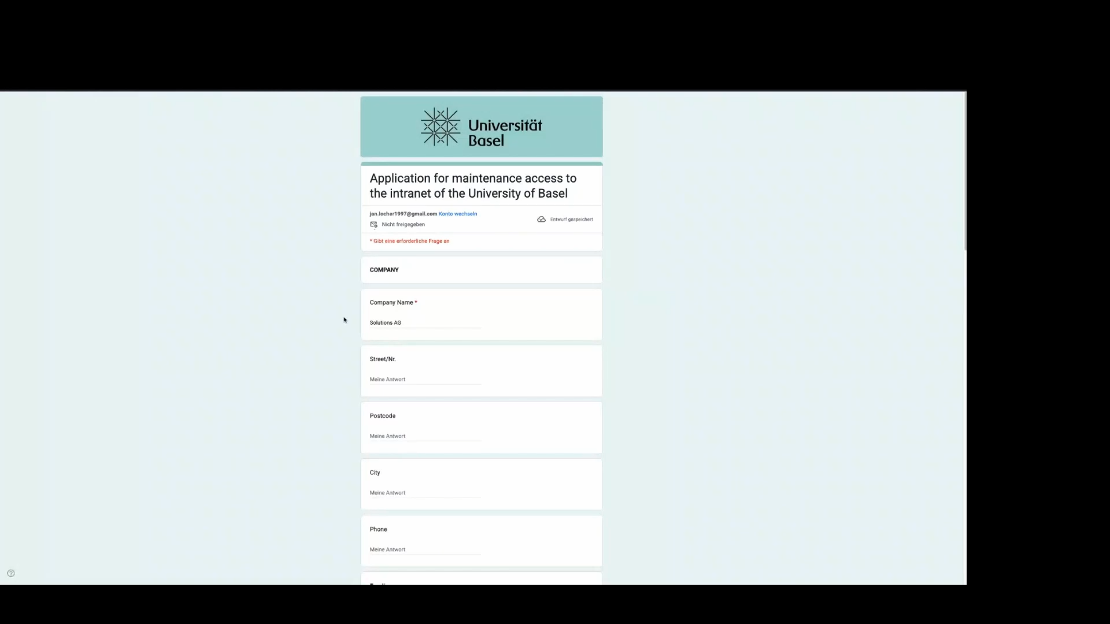
Demo
Notes:
2.5 Minutes - Jan

Slide 7
Demo (emails)

Slide 8
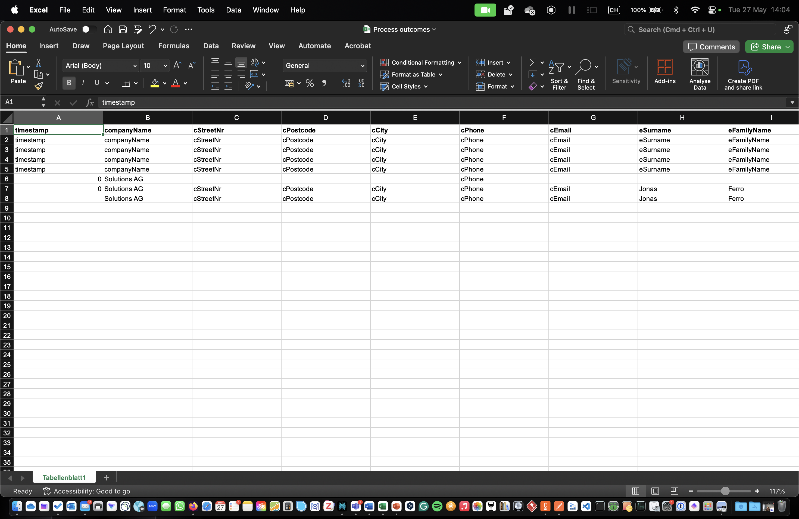
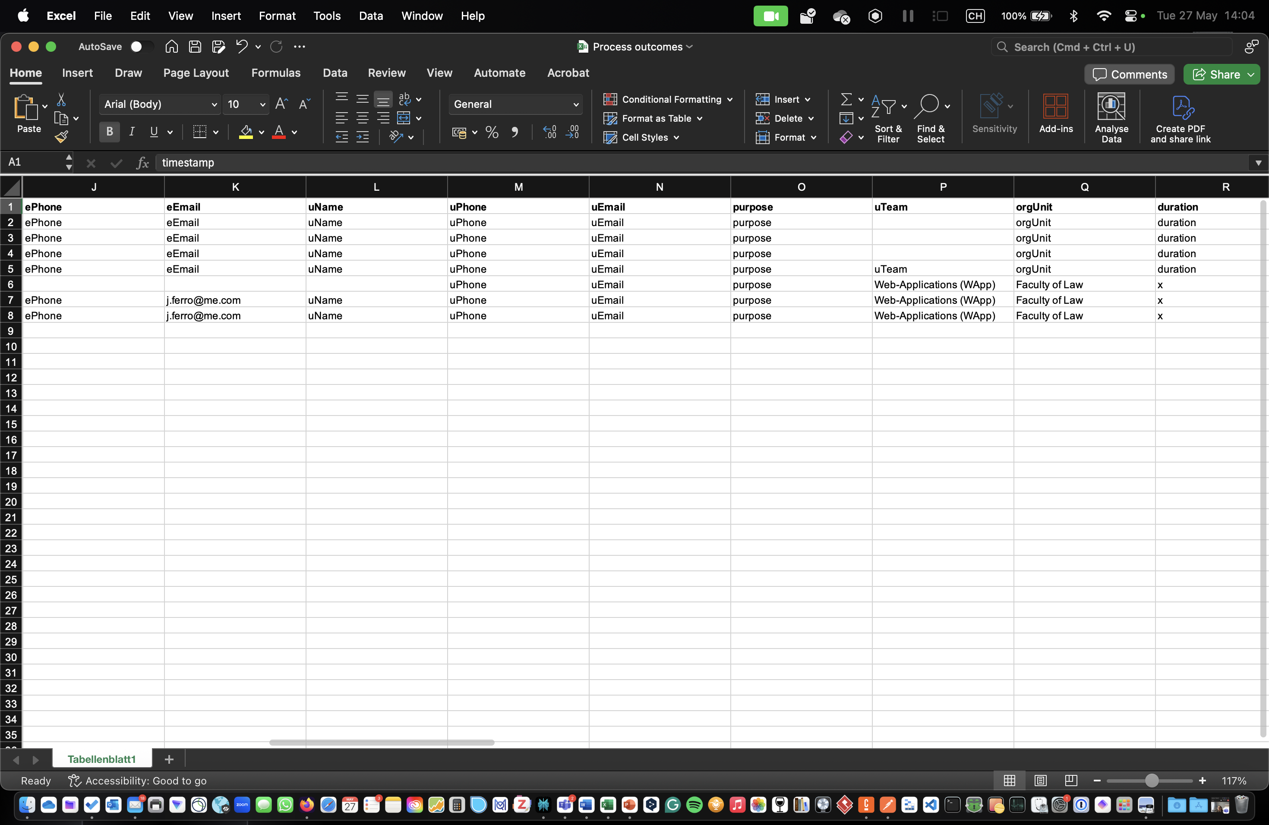
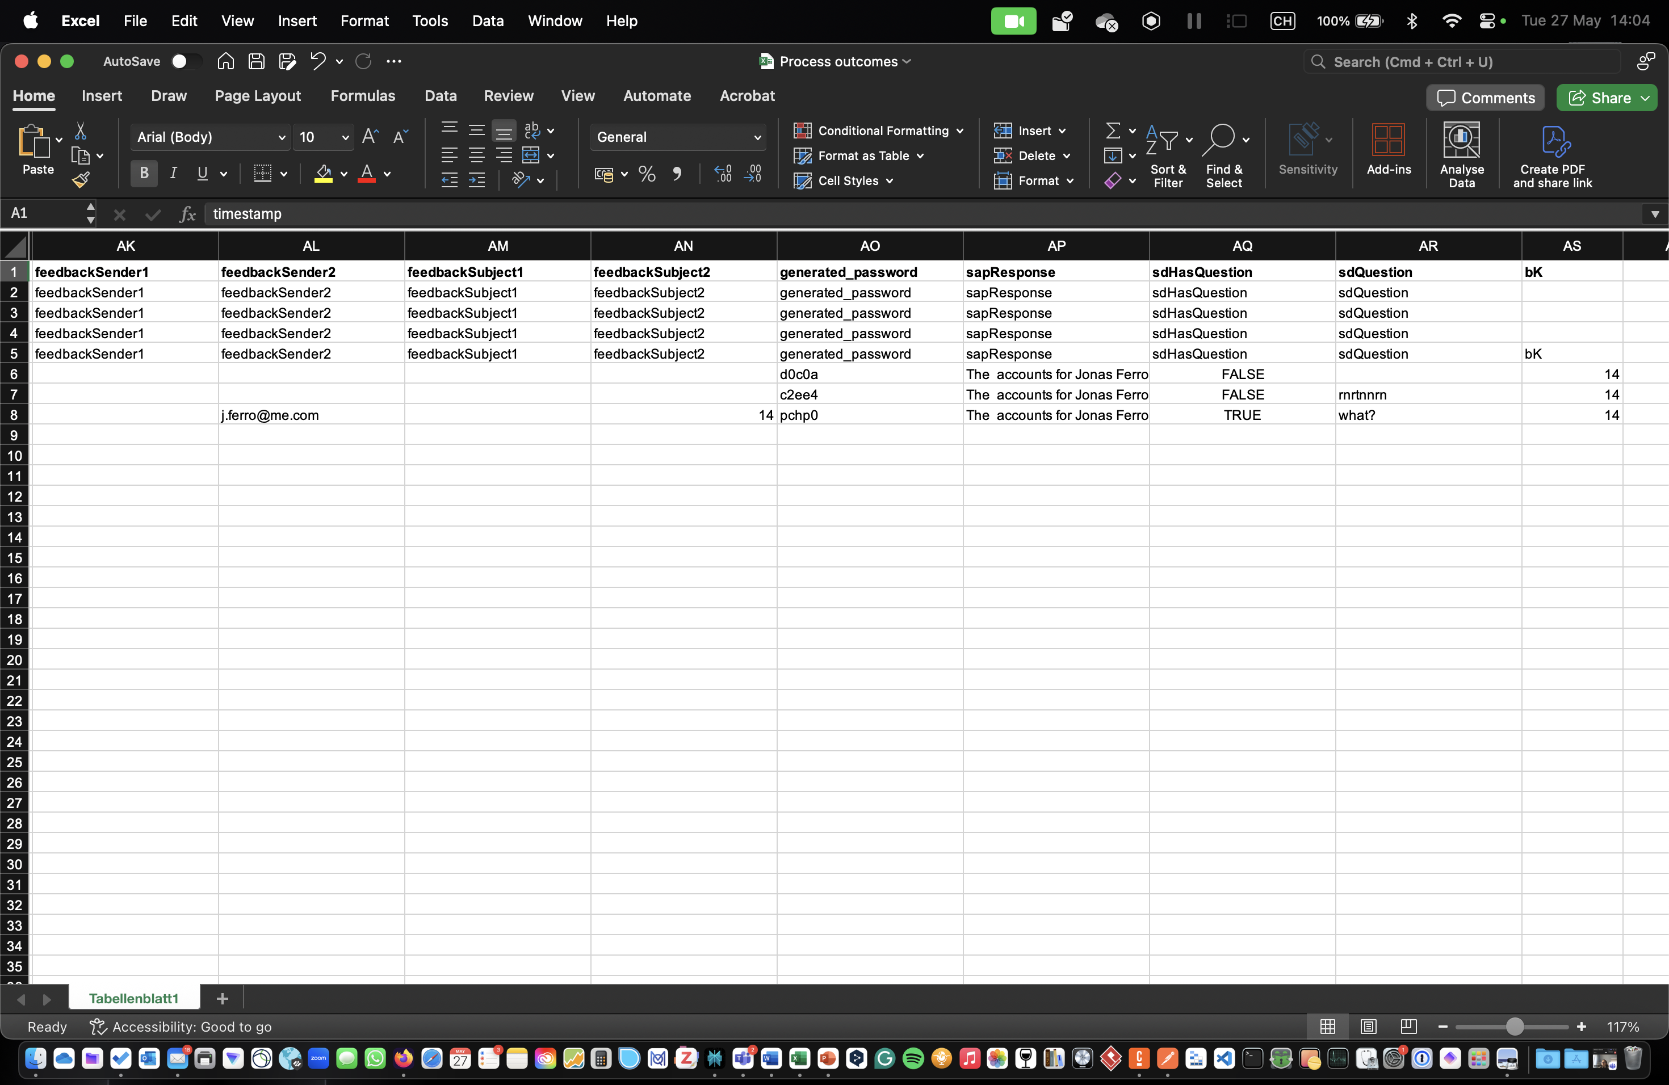
Demo (storing results)

Slide 9

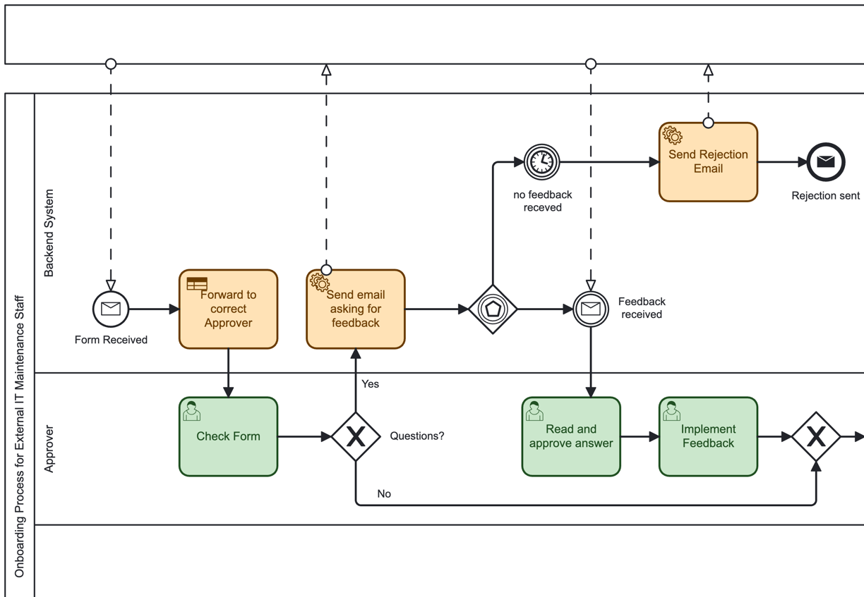


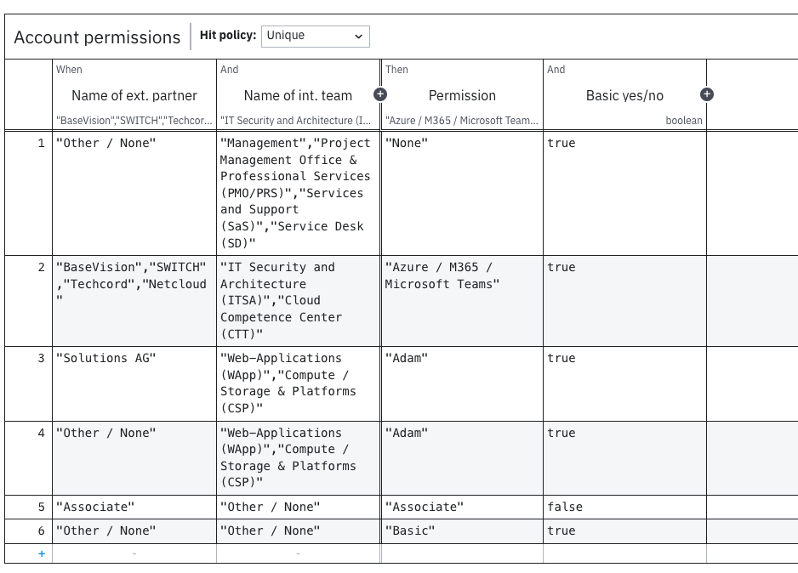

Conclusion
Inconsistent Process
Execution
Transparency & Standardization
Back and Forth Communication
Manual Effort
Error Handling
⚠️
✅
✅
✅
⚠️
→Process takes 1 week instead of 2 weeks before
Notes:
1.5 Minutes - Justine
Inconsistent Process Execution: every team made it differently – Now camunda
Lack of transparency & standardization: Now Excel sheet to store data
Applicants always know what’s happening → automated email
Manual effort: reduced via the digital form and automated emails
Removed partially human errors → implementation of DMN table: Now goes to the right approver
Originally, the process was highly inconsistent — every team had its own approach. Now, with Camunda orchestrating everything, we ensure consistent execution across all departments.
2. There was also a lack of transparency. Today, all form data is stored in structured Excel sheets, and every step is trackable with camunda. Also the email notifications helps the transparency
3. We reduced manual effort by integrating a digital Google Forms. No more copying, pasting, or sending repetitive emails. We reduced manual effort by integrating Google Forms and decision tables. No more copying, pasting, or sending repetitive emails.”
4. Applicants no longer need to guess what's happening — they get automated emails at every stage, whether it's confirmation, feedback, or rejection.
5. Communication between applicant, approver, and IT Service Desk is now smooth and fast thanks to automation.
6. And finally, although full error handling is still a work in progress, we’ve already reduced human mistakes by implementing a digital form and using decision tables. Now, every request goes to the correct approver automatically.

Slide 10
Thank you for your Attention !

Slide 11
Back-Up Slides

Slide 12
Link GitHub
https://github.com/DigiBP/25DIGIBP3?tab=readme-ov-file

Slide 13


What we built
Notes:
I’ll take you through what it’s like for the user.”
Steps need to be cross checked with process !!!
“Step 1: The external partner fills in a Google Form. Step 2: An email instantly confirms that the request was received. Step 3: The approver reviews the request. If anything is missing, a feedback request email is sent. Step 4: The system decides, using a DMN table, what permissions are needed and who should approve. Step 5: Once approved, we trigger SAP IDM through Make to simulate account creation. Step 6: The applicant is informed via email that their credentials will arrive by post.”
“It’s simple, transparent, and fast.”

Slide 14
What we built
Notes:
I’ll take you through what it’s like for the user.”
Steps need to be cross checked with process !!!
“Step 1: The external partner fills in a Google Form. Step 2: An email instantly confirms that the request was received. Step 3: The approver reviews the request. If anything is missing, a feedback request email is sent. Step 4: The system decides, using a DMN table, what permissions are needed and who should approve. Step 5: Once approved, we trigger SAP IDM through Make to simulate account creation. Step 6: The applicant is informed via email that their credentials will arrive by post.”
“It’s simple, transparent, and fast.”

